Slide 1
Deep Image Retrieval
Content Based Image Retrieval

Slide 2
Introduction of CBIR
Content Based Image Retrieval(CBIR)
The problem of searching for semantically matched or similar images in a large image gallery.
CBIR can be categorized into instance level and category level.
instance level: to find images containing the same object.
category level: to find images of the same class.
Nearly endless potential for applications of CBIR, such as:
person re-identification, remote sensing, medical image search, and shopping recommendation.

Slide 3
The challenges of CBIR
Reducing the semantic gap
Improving retrieval scalability
Available pre-trained model for classification tasks leads to a challenge in extracting features.
Balancing retrieval accuracy and efficiency
Available method: hash learning(learning-to-hash)

Slide 4
Summary of progress in deep learning
Recent progress can be categorized into:
Network-level:
network architecture improvement
network fine-tuning strategies
Feature-level:
feature extraction
feature enhancement(used to improve the discriminative ability)

Slide 5
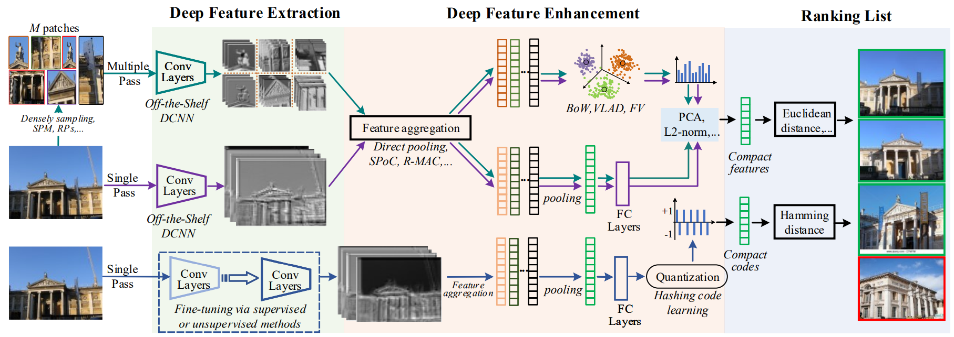

Slide 6
Feature Extraction
The fully-connected layer has a global receptive field.
These features are used for similarity measurement without further processing.
This property leads to two obvious limitations:
a lack of spatial information
a lack of local geometric invariance
Features from convolutional layers preserve more structural details and robustness for instance-level retrieval.

Slide 7
Feature Enhancement
Feature enhancement methods aggregate or embed features to improve the discrimination.
Feature aggregation: sum/avg/max pooling
Feature embedding: high dimensional features to compact features.
Notes:
Feature embedding: BoW, VLAD, FV = PCA랑 유사한듯?

Slide 8
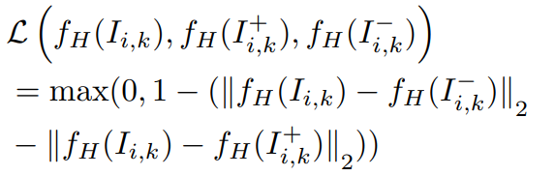


Hash Learning
Binary vector embeddings enable fast nearest neighbor retrieval in large databases of high-dimensional objects.
The deep hashing method maps the input raw images to hash codes directly.
It aims to learn a compact and similarity-preserving bitwise representation such that similar inputs are mapped to nearby binary hash codes.
Improving hash function quality aims at making the binary codes uniformly distributed.
maximally filling and using the hash code space
Loss: Hash Code:
Notes:
Supervised Hashing for Image Retrieval via Image Representation Learning
Deep Image Retrieval A Survey
Part-based Deep Hashing for Large-scale Person Re-identification

Slide 9
Fine Tuning
Classification-based Fine-tuning
It may have some difficulties in learning discriminative intra-class variability to distinguish.
Verification-based Fine-tuning
Compared to classification-based learning, verification-based learning focuses on both inter-class and intra-class samples.

Slide 10
In Production

Slide 11
Approximate Nearest Neighbor Search
Nearest neighbor search finds an object in a reference database which has the smallest distance to a query object.
Due to the curse of dimensionality, it is commonly believed that it is very costly to find the exact nearest neighbor in high dimensional Euclidean space.
Approximate Nearest neighbor search (ANNS) is fundamental and essential operation in applications from many domains, such as:
databases, machine learning, multimedia, and computer vision.
Notes:
Approximate Nearest Neighbor Search on High Dimensional Data Experiments, Analyses, and

Slide 12
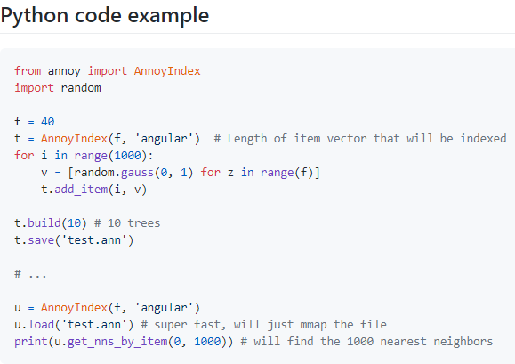
Annoy (Approximate Nearest Neighbors Oh Yeah)
It is a C++ library with Python bindings to search for points in space that are close to a given query point.
It can use static files as indexes. In particular, this means you can share index across processes.
Summary of features:
Euclidean distance, Manhattan distance, cosine distance, Hamming distance, or Dot (Inner) Product distance
Let's you share memory between multiple processes
Build index on disk to enable indexing big datasets that won't fit into memory
Spotify use it for music recommendations.

Slide 13
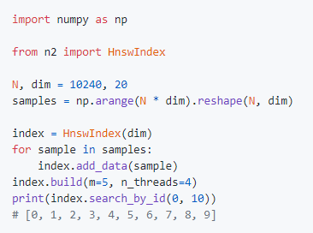
N2 (made by kakao)
Lightweight approximate Nearest Neighbor algorithm library written in C++ (with Python bindings).
Summary of features:
Supports multi-core CPUs for index building.

